Slide 1

Capstone Project
Customer Purchase Behaviour in Spotify User
IBEKWE DIVINE UFOK

Slide 2
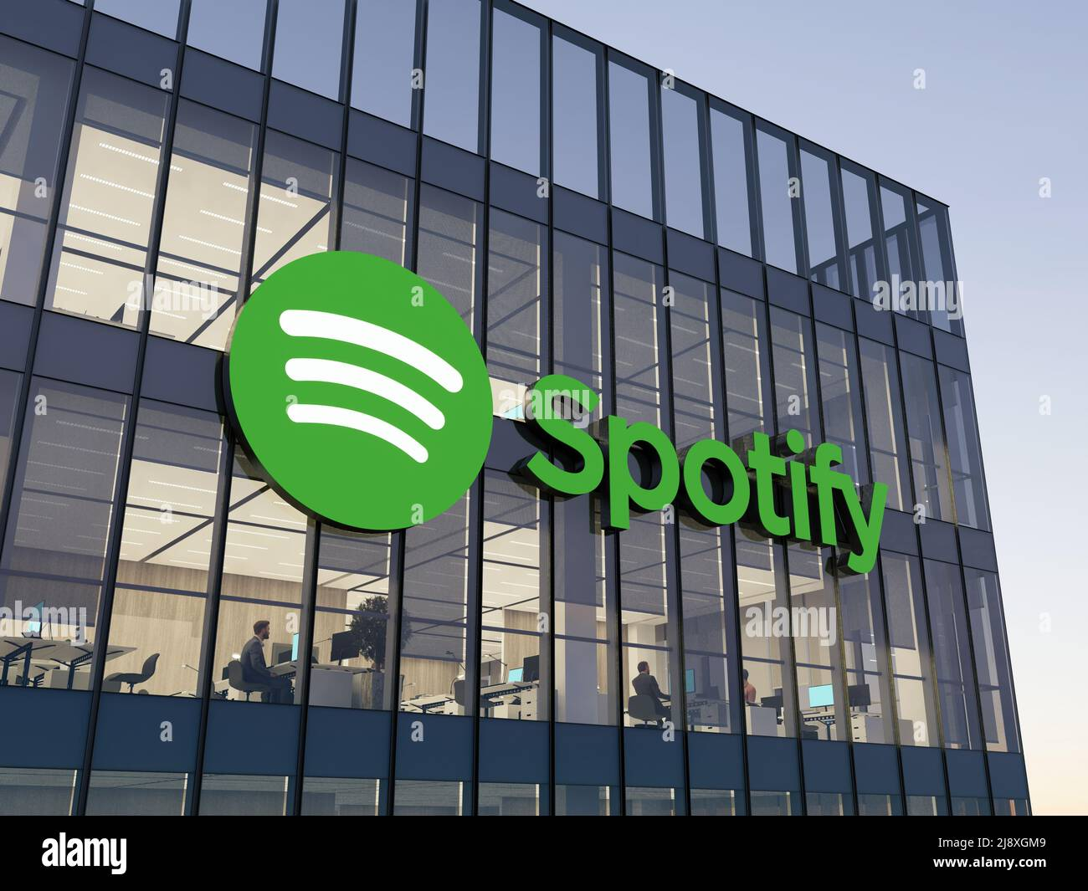
Outline
1
Problem Statement.
2
Data Overview.
3
Data Cleaning.
4
Findings and Visual Metrics.
5
Model.
6
Recommendations
7
Limitations and Suggestion

Slide 3

PROBLEM STATEMENT
To analyse and predict whether a Spotify user will choose a free or premium subscription plan, using data on their demographics, music genre preferences, and listening behaviour, so that Spotify can better target users for premium conversion, improve retention strategies, and increase revenue.
Expected output: Improved user retention, premium conversion, and increased subscription revenue.

Slide 4

DATA OVERVIEW
Features in the Data Set
Age (categorical)
Gender (categorical)
Preferred premium plan (categorical)
Favourite music genre (Categorical)
Music recommendations rating (numerical)
520
Total Users
424
The data set used in this analysis is Spotify_data.csv
It was gotten from a survey carried out on Spotify users.
The data contains categorical data and numerical data.
The dataset was loaded using Pandas’ read_csv()
Free Plan Users
Target
96
spotify_subscription_plan
Premium Users

Slide 5

DATA CLEANING
Explanation
isna().sum() is the method that was used to check for missing values.
Explanation
This code specifies creates a custom list of what constitutes as missing values and purposefully excludes the word ‘None’.

Slide 6
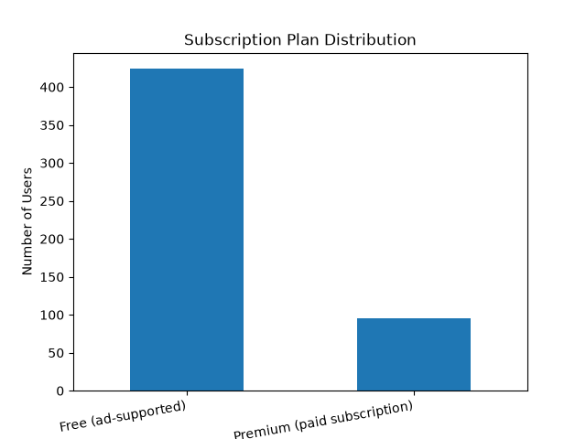
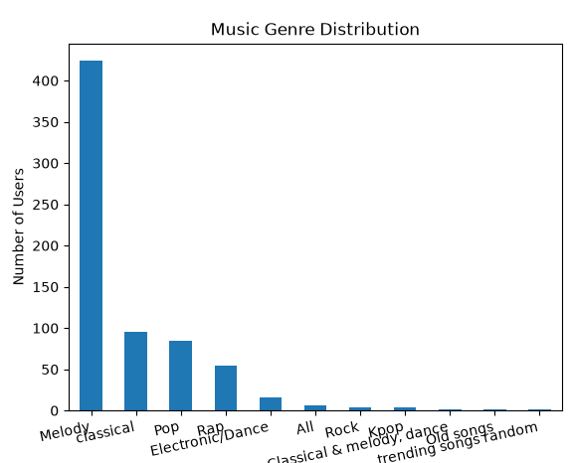
FINDINGS AND VISUAL METRICS
Free (ad-supported) users dominate the platform making up approximately 420 users compared to the premium (paid subscription) users who make up approximately 95 users.
Melody is the most listened to music genre amongst Spotify users.

Slide 7
MODEL
The model used in this project is Logistic Regression
Steps
Why Logistic Regression?
Logistic Regression was chosen because the problem is a binary classification task which suits the model natively.
The target variable spotify_subscription_plan has exactly two outcomes: Free (ad-supported) or Premium (paid subscription).
1
Features (X)
1
All columns except spotify_subscription_plan
2
Target (y)
2
spotify_subscription_plan
3
Encoding
3
pd.get_dummies(X) --one-hot encoding (converts categorical text data into numbers that the M.L model can understand).
4
Train/Test Split
Libraries Used
4
80% training, 20% testing · random_state=42.
pandas — data loading & manipulation
matplotlib — visualisation
scikit-learn — train_test_split, LogisticRegression, accuracy_score
5
Algorithm
5
LogisticRegression() from sklearn — suitable for binary classification
6
Evaluation
6
Accuracy score on test set (approx. 72%)

Slide 8
RECOMMENDATIONS
1. Focus on converting free users to premium
2. Leverage Melody listeners
96 out of 520 users from the survey indicated that they used free plan, as a result Spotify should introduce time-limited free trials of premium to give free users a taste of the ad-free experience, making it easier to convert them.
Melody was by far the most popular genre with 420+ users. Spotify could create exclusive premium-only Melody playlists and use that as an incentive to push free Melody listeners toward upgrading.
3. Target marketing by age
4. Improve the premium value proposition
Since age is one of the features in the data, Spotify should design age-specific campaigns — for example, student discounts for younger users and family plans for older ones.
With such a large free user base, many users clearly don't feel premium is worth paying for. Spotify should highlight premium benefits more clearly especially to high-engagement free users.

Slide 9
LIMITATIONS AND SUGGESTIONS
Limitations
Suggestions
Small dataset: Only ~520 users were surveyed. That's not enough to confidently represent all Spotify users worldwide. The findings may not hold true on a larger scale.
Self-reported data: The data came from a survey, meaning users answered questions themselves. People don't always remember or accurately report their listening habits, so some answers may not reflect reality.
Uneven classes: 81% of the data is free users and only 19% is premium. This imbalance means the model is much better at predicting free users than premium users, which skews the results.
Model simplicity: Logistic Regression draws a straight line to separate the two groups. Real user behaviour is more complex than that, so the model may be missing patterns a more advanced model would catch.
No time element: The data is a one-time snapshot. It doesn't show how user behaviour changes over time, which limits how useful the insights are for long-term decisions.
Collect more data: A larger, more diverse dataset would make the findings more reliable and generalisable.
Fix the class imbalance: Use techniques like SMOTE to balance the free vs premium split before training the model.
Try better models: Test Random Forest or XGBoost to see if they can find deeper patterns and improve accuracy.
Identify top predictors : Do a deeper analysis to find out exactly which features most influence whether a user goes premium.

Slide 10


